Slide 1
4. Social Media Location Analytics
Amit Aylani

Slide 2
Contents
Sources of Location Data
Categories of Location Analytics
Location Analytics and Privacy Concerns
Location Analytics Tools

Slide 3
Location Analytics
Location analytics, also known as spatial analysis or geo-analytics, involves mapping, visualizing, and mining the location of people, data, and other resources.
GPS-enabled mobile devices make it possible to provide location-based services, products, and information.
Location analytics can be used in various sectors and can be instrumental in understanding cities and human behaviors in space and time.
An example of location analytics is the use of geo-located Twitter data to study of New York City (França, Sayama et al. 2015) the "heartbeat" dataset of a city and map its dynamics.

Slide 4
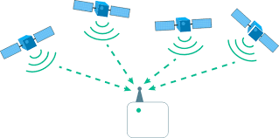
Sources of Location Data
Postal Address
Latitude Longitude
GPS-based
IP-based

Slide 5
Categories of Location Analytics
Based on its scope, location analytics can be broadly classified into two categories:
1) Business data-driven location analytics
2) Social media data- driven location analytics.

Slide 6
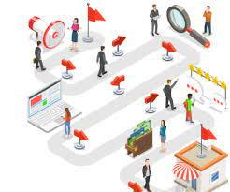
Business Driven Location Analytics
Business data-driven location analytics involves mapping, visualizing, and mining location data to reveal patterns and trends in business data.
By capitalizing on data stored in a business database, location analytics can provide location-specific information, products, and services based on where customers are.
Examples of how this can be used include recommending the nearest convenience store or taxi, or making decisions about the best potential location for a business warehouse.

Slide 7
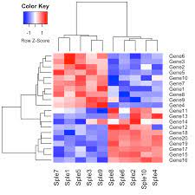
Applications of Business Driven Location Analytics
Powerful Intelligence
Simple maps can be useful,
sophisticated mapping techniques like
Clustering,
Heat mapping,
Data aggregation
Color-coded mapping can provide more detailed and insightful business intelligence.

Slide 8
Applications of Business Driven Location Analytics
Geo Enrichment
Simple data maps can be enhanced with customer information such as demographics, spending habits, lifestyle, and location.
This can help to answer questions such as where a company's loyal customers spend most of their time.

Slide 9
Applications of Business Driven Location Analytics
Collaboration and Sharing
Maps are easy to understand and are useful for communication and collaboration within an organization.
Location analytics can be used to map business data for collaboration and information sharing with customers.
Business data -Google Fusion Tables, allows for the creation of maps, tables, and charts.

Slide 10
2) Social Media Data Driven Location Analytics
Recommendation Purposes
Customer Segmentation -Tweepsmap (https://tweepsmap.com/), can be used to geo-locate your Twitter followers by country, state, or city.
Advertisement-Location-based advertisement allows targeted marketing and promotion campaign mostly delivered through mobile devices to reach specific target audiences.
Information Request- Based on their current location, customers can request a product, service, or resource (e.g., the nearest coffee shop, restaurant, or parking lot).
Alerts - Location data can be used to send and receive alerts and notifications, such as sales and promotion alerts traffic congestion alerts, speed limit warnings, and storm warnings etc.
Search and Rescue - Location data is vital in search and rescue operations e.g. disaster management.
Navigation - Mobile and GPS-based navigation services and apps can help users find addresses. An example of this is the BE-ON-ROAD app for Android devices, which offers offline turn-by-turn GPS navigation.

Slide 11
Location Analytics and Privacy Concerns
Location-based services can bring convenience and value to businesses, but they also raise privacy concerns.
These concerns include the need for transparency about location tracking, user control over the storage of location information, and options for preserving anonymity.
There are also questions about legal protection for historical location data against unreasonable searches, and the appropriate level of disclosure control.
There is a need for appropriate governmental regulation to protect citizens' privacy rights in the era of location-aware mobile devices.

Slide 12
Location Analytics Tools
Google Fusion Tables is a web service for geo-tagging, storing, sharing, querying, and visualizing tabular business data on Google Maps.
Agos is a platform for geo-tagging and reporting that helps communities address climate change and disaster risk reduction.
Tweepsmap maps Twitter followers by location.
Trendsmap is a real-time tool that maps the latest trends from Twitter.
Followerwonk is a tool for performing basic Twitter analytics such as analyzing followers, location, and tweeting patterns.
Esri's GIS software is used for mapping, visualizing, questioning, analyzing, and interpreting data to understand relationships, patterns, and trends.

Slide 13
Questions
Define location analytics.
Explain the two main categories of location analytics.
What are the sources of location data.
What are the main applications of business data-driven location analytics?
What are the main applications of social media data-driven location analytics?
Discuss privacy concerns related to location analytics.

